Slide 1


SIMPLE SALES DASHBOARD DESIGN
Muntha Hanush
03, Oct, 2025

Slide 2
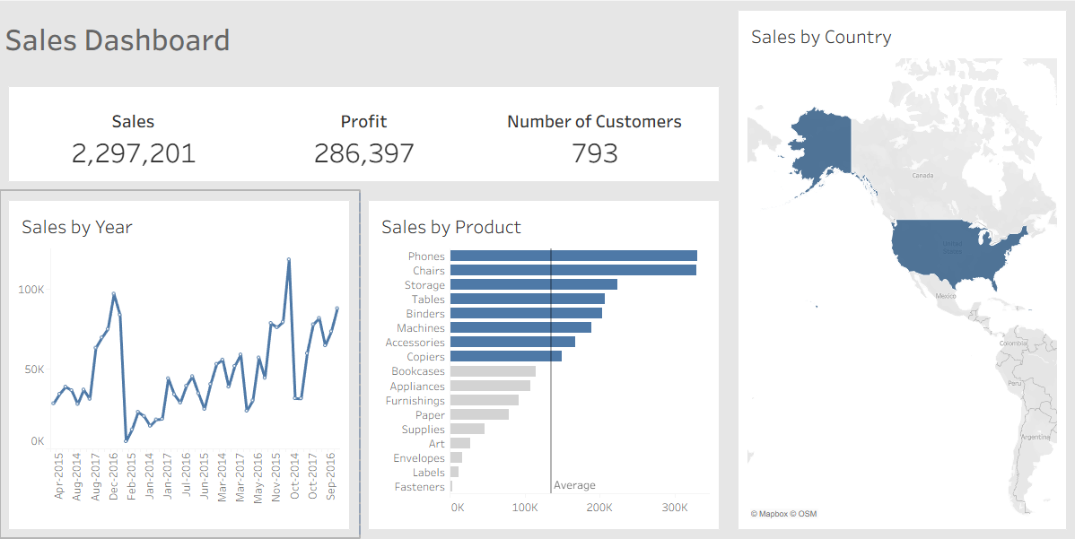
SALES DASHBOARD OVERVIEW
Introducing a dynamic sales dashboard for actionable business decision-making.
Dataset includes key metrics across sales, profit, customer count, yearly trend, product categories, and geographical distribution.

Slide 3
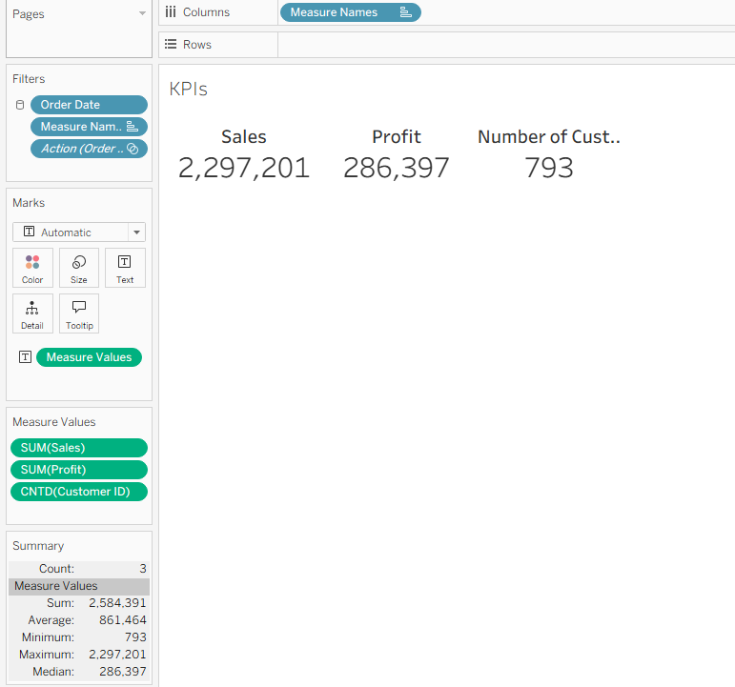
DASHBOARD KPIS
Sales: Total sales amount stands at 2,297,201, reflecting strong market presence.
Profit: Profits of 286,397 indicate healthy financial performance.
Number of Customers: With 793 unique customers, the business has a substantial customer base.

Slide 4
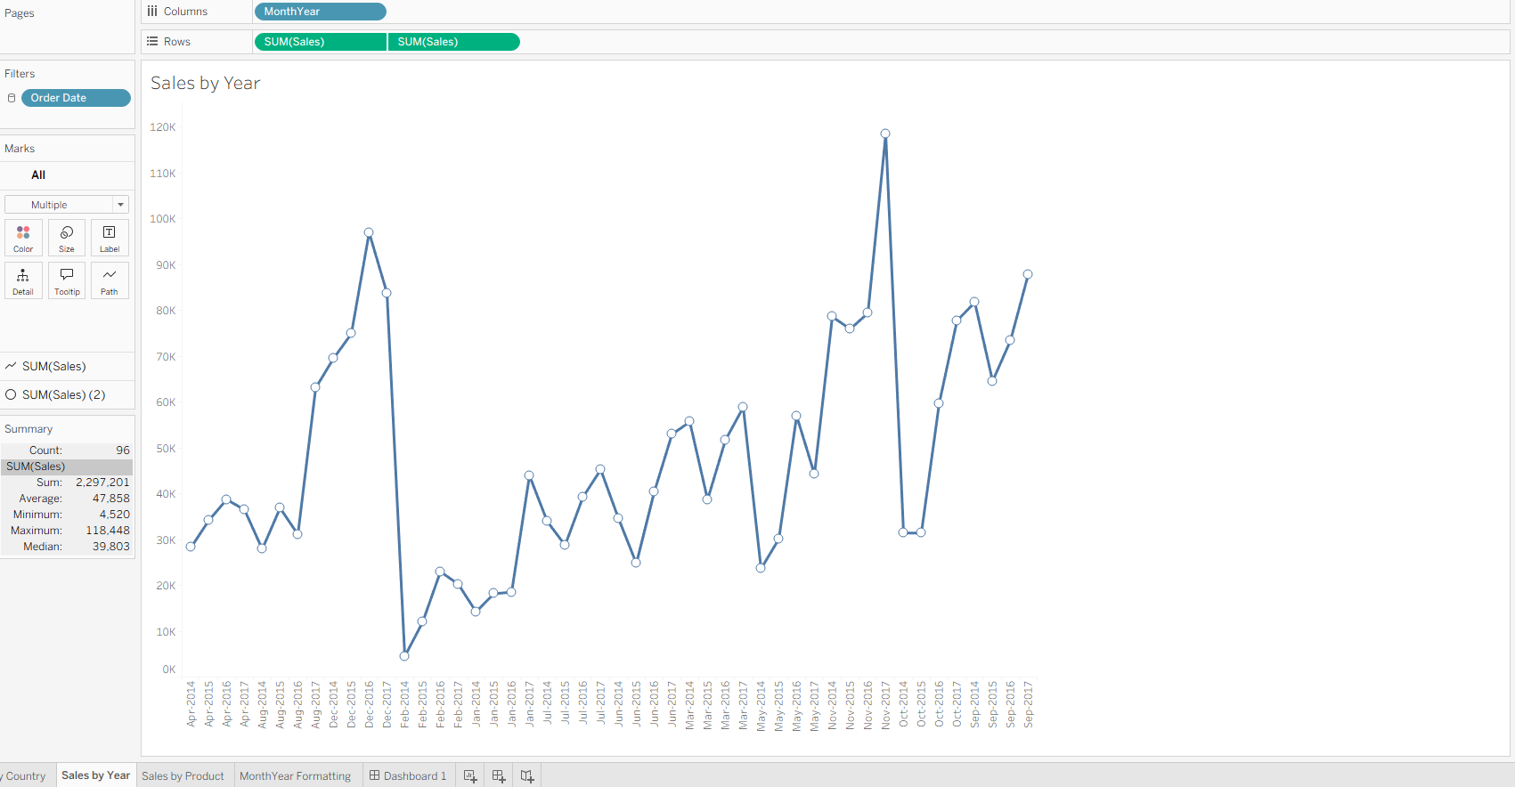
SALES TREND ANALYSIS (TIME-SERIES)
The "Sales by Year" chart displays fluctuations and seasonal trends over the measured period.
Spikes in sales correlate with key business activities or peak seasons, providing insight for forecasting and planning.
The time-series helps pinpoint periods of growth and areas needing improvement.

Slide 5
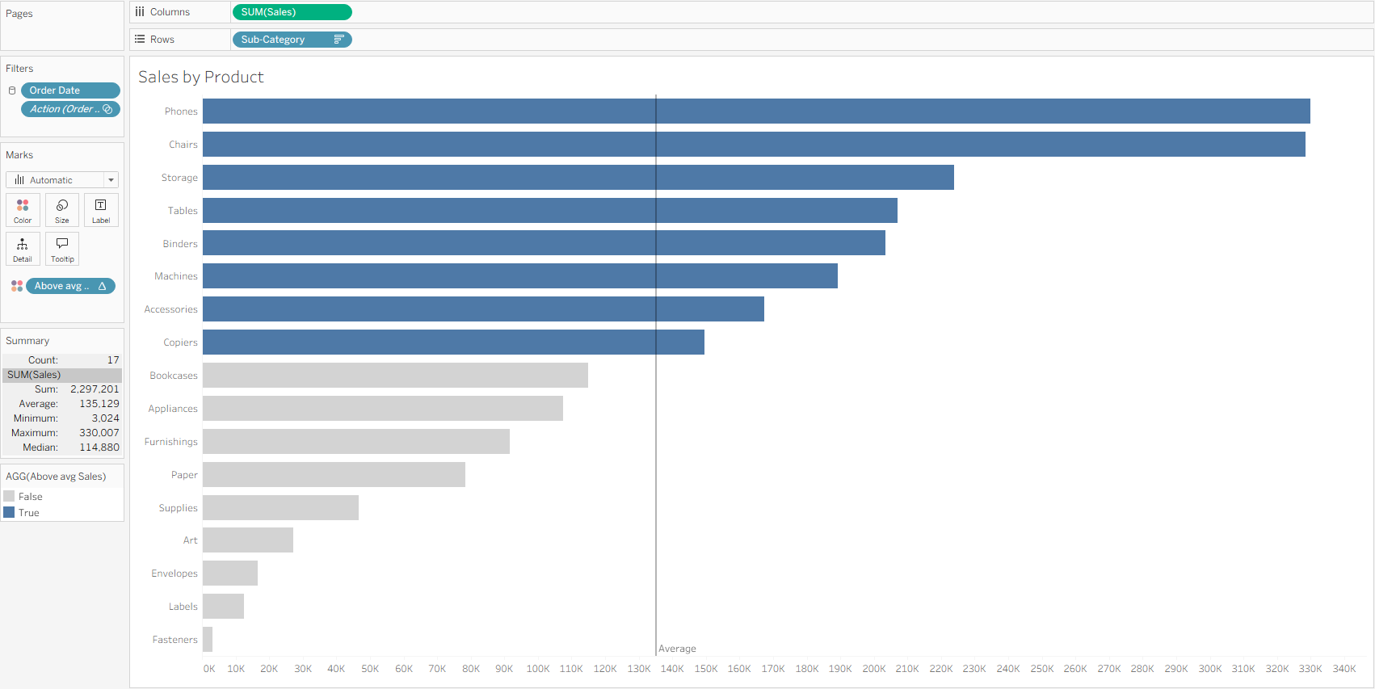
PRODUCT PERFORMANCE ANALYSIS
"Sales by Product" highlights Phones and Chairs as top revenue drivers, outperforming other categories.
Products such as Storage, Tables, and Binders contribute significantly above the average.
Lower-performing products (e.g., Fasteners, Labels) may warrant reassessment or targeted marketing strategies.

Slide 6
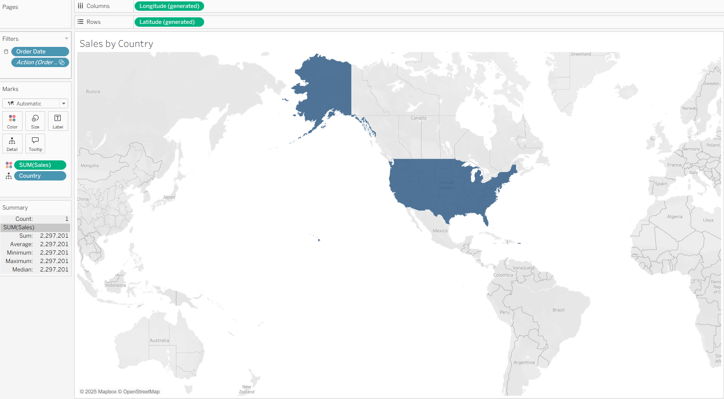
GEOGRAPHICAL INSIGHTS
The map visual (“Sales by Country”) shows sales distribution, with the United States as the dominant market.
Geographic insights help identify regional opportunities and inform territory expansion or resource allocation.
The dashboard enables location-based decision-making at both country and regional levels.

Slide 7
INTERACTIVITY AND USABILITY
Stakeholders can dynamically filter the data by year, product, or geography for custom views.
Real-time insights empower teams to drill into details or focus on specific KPIs as needed.
Consistent color theme and intuitive layout ensure clarity and accessibility in stakeholder meetings.

Slide 8
BUSINESS RECOMMENDATIONS
Focus investment and marketing on high-performing products and regions.
Analyze low-volume months/years to optimize sales cycles or promotions.
Harness geographic strengths while exploring new markets for strategic growth.

Slide 9
THANK YOU

